Slide 1
How Sports Impact Media and Society
C101 Media
March 9 & 10, 2020

Slide 2
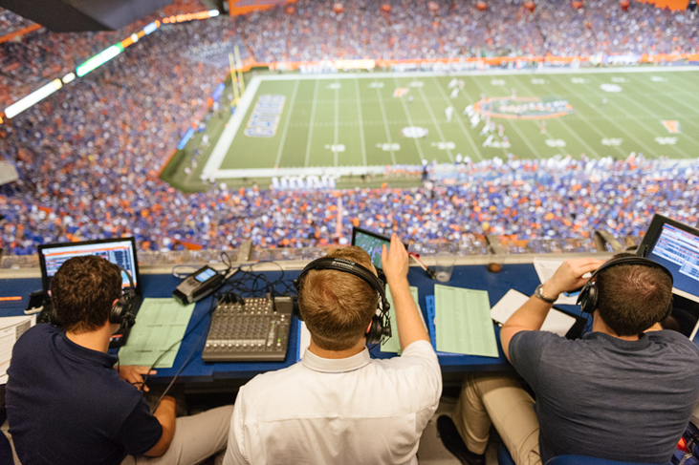
Sports and Media
Sports have been historically viewed as the least “serious” part of media
Sports departments in newspaper newsrooms were called the “Toy Department”
And yet…

Slide 3

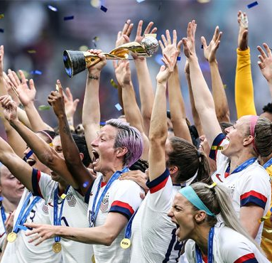
Sports and Media
Sports has become one of the biggest audience drivers in media
Sports issues and controversies increasingly act as avatars for societal issues and controversies
Sports stretches across political and cultural boundaries in ways few other things can

Slide 4
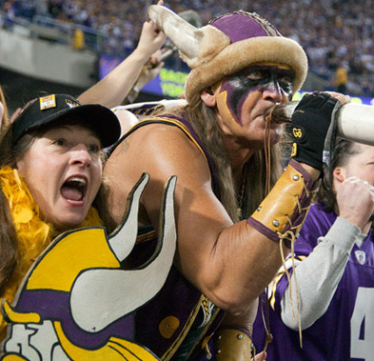
Why are Sports so popular?
Athletic competition acts as a universal form of communication that doesn’t always require language
Technology has changed how we consume almost all media…but not sports
One of the very few things we still must consume “live”
Sports provide you a group to be a part of…and a group to be against

Slide 5
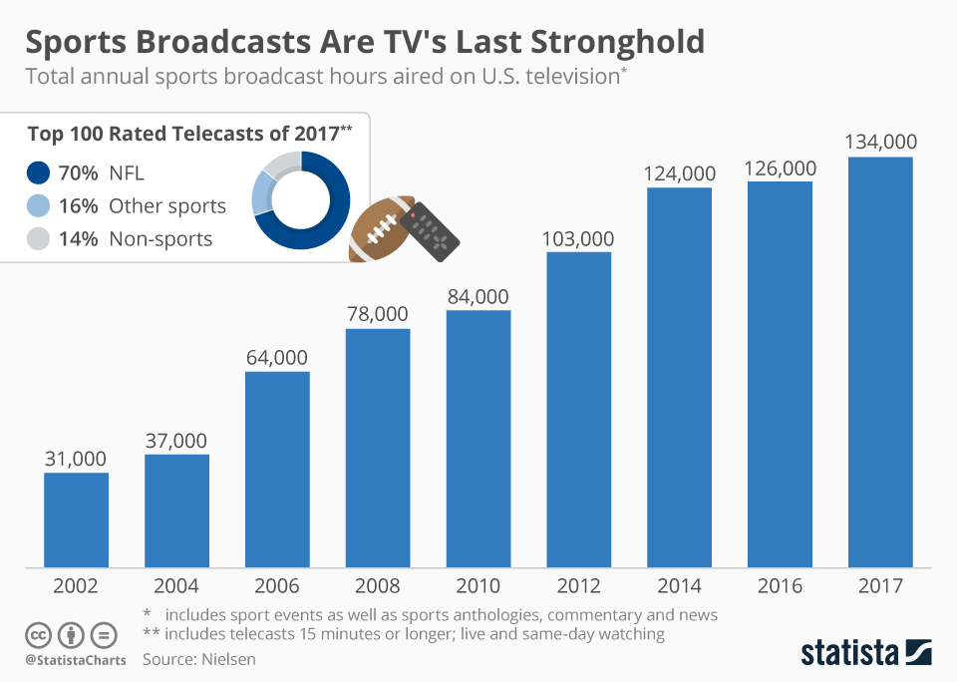
Sports and Media work in tandem
Historically, media and sports organizations worked in tandem
Media would cover sports organizations
Sports fans would consume media
Profit!
Increasingly, media rely on sports to reach important demographics
Thursday Night Football on FOX: Twice the 18-49 demo viewership as ABC, CBS, and NBC *combined*
Among adults 18-49, 31 of the top 50 TV shows in 2018 were National Football League broadcasts

Slide 6
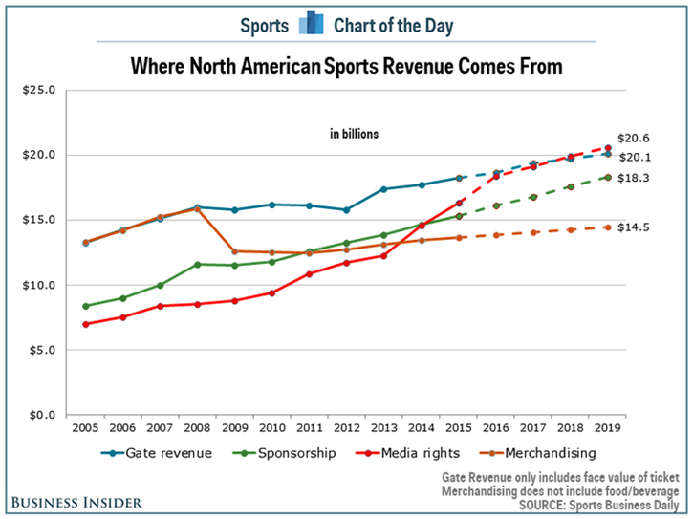
Media and Revenue in Sports
In many cases, sports organizations have also become media organizations
Teams use social media to reach audiences directly
Leagues own and operate their own TV stations
Direct competition with traditional media for attention and audience
Media organizations have financed a broad expansion of sports over the past three decades

Slide 7
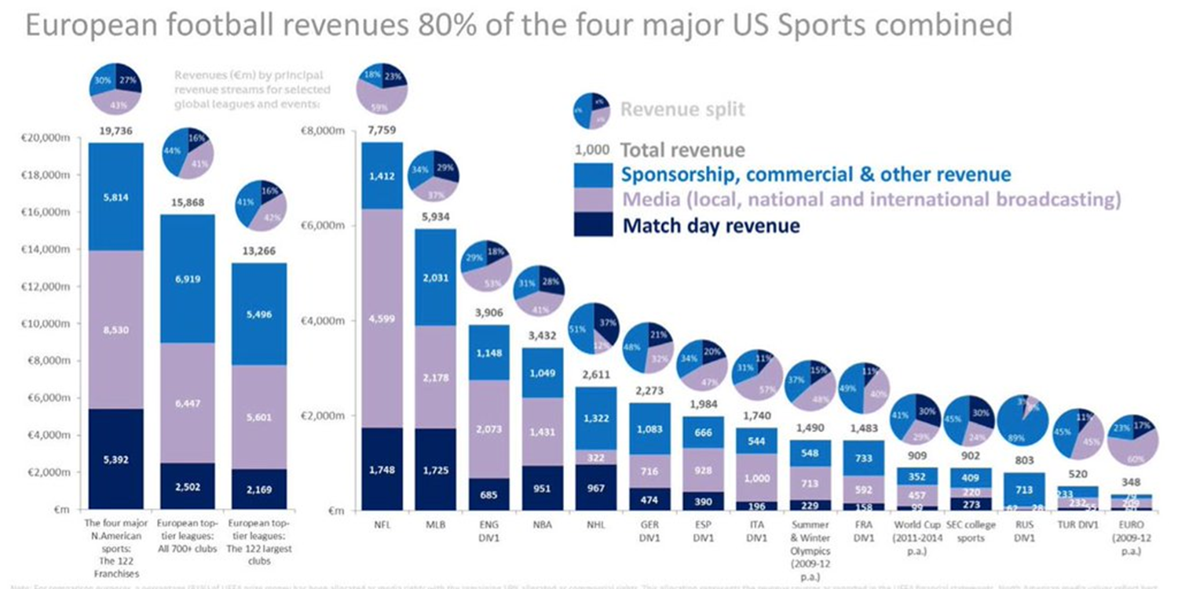

Slide 8
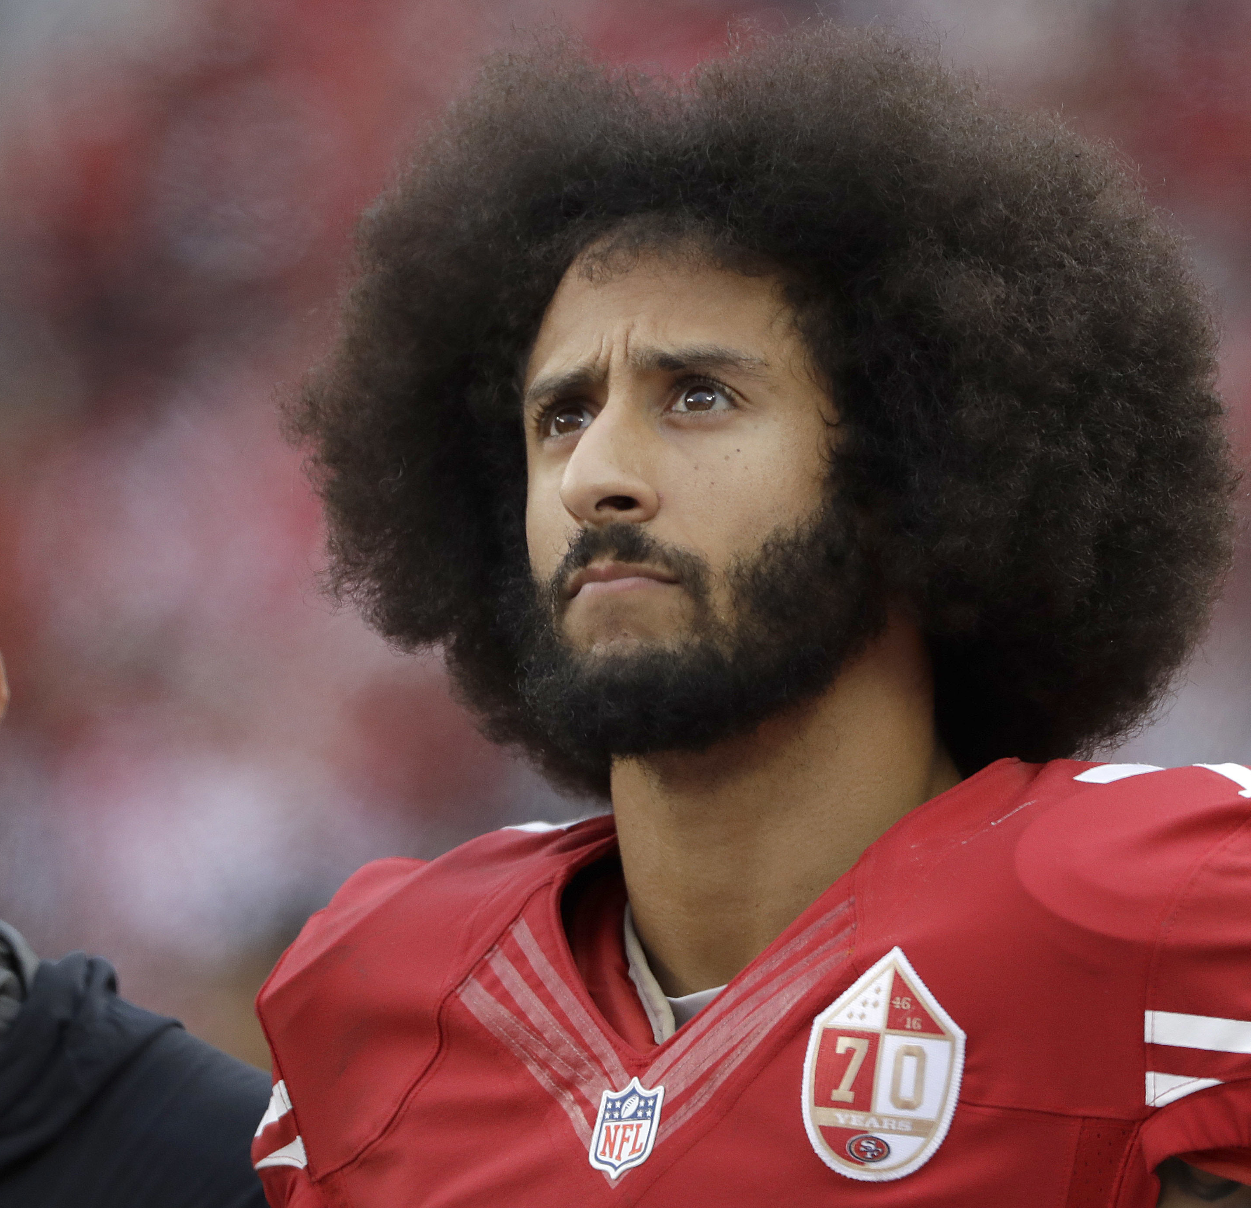
Sports and Societal Issues
Sports issues increasingly matter as battlegrounds for social inequality, political disputes, and cultural upheaval
How race, gender, sexuality, and culture are portrayed within sports
Athletes as agents of social change, and how that affects the larger political arena

Slide 9
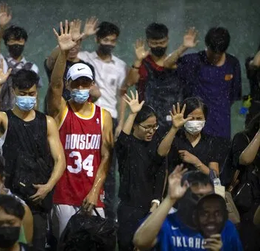
Sports and Societal Issues
The “amateur athletics” system and its societal implications
The “Fair Pay to Play Act”
Geopolitical issues that cross borders
The NBA, China, and Hong Kong
The rise of esports and the truly global audience
League of Legends 2018 World Championship Finals

Slide 10
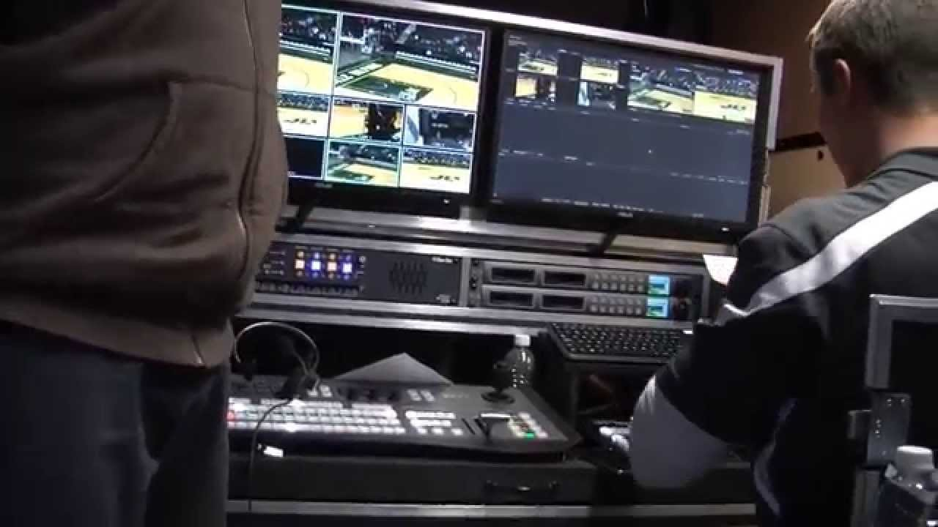
Plentiful career paths in sports media
Types of Jobs
Journalist / Independent Media
Content / Sports Organization
Types of Content
Audio
On-Camera
Production
Writing
Social Media

Slide 11
Opportunities at Indiana University
Sports Media concentration (15 hours)
Sports Journalism specialization
Specific courses in sports media
Hands-on opportunities across student media
Internship opportunities across the industry
Experience is Paramount
gclavio2@Indiana.edu

Slide 12

Questions

